Slide 1
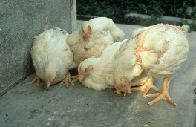
poultry diseases 1
fourth stage
شعار الكلية
chapter one – lecture 1
Introduction to Poultry Diseases
Dr.Harith Abdulla
Department of Pathology and Poultry Disease
College of Veterinary Medicine University of Basrah
University of Basrah- College of veterinary medicine- Department of Pathology and Poultry Disease

Slide 2
WHAT IS A DISEASE?
In common terms, a disease is an abnormal condition that is caused by infection, basic weaknesses, or environmental stress.
A disease is defined by a specific group of signs or symptoms.

Slide 3
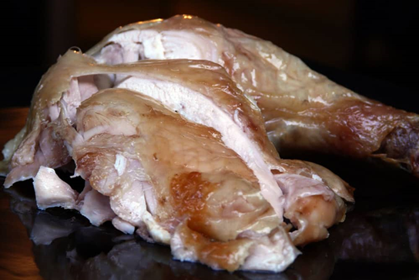
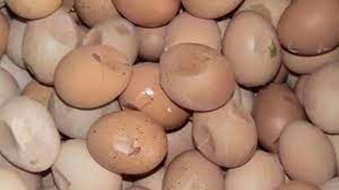
This can result in poor productivity and reduced quality of the affected animals.
It could even lead to the death/loss of one or all of the birds in a flock.

Slide 4
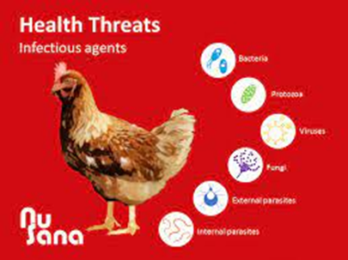
Infectious agents
Infectious diseases are caused by viruses, bacteria, and fungi. Parasitic diseases are caused by protozoa, worms, and external parasites such as mites and lice.

Slide 5
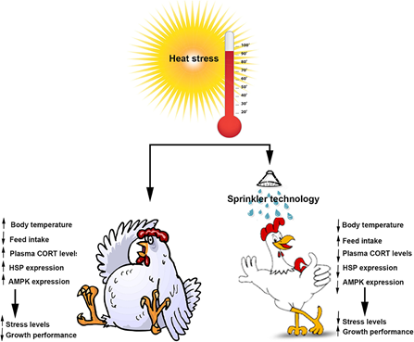
Environmental stress
Temperature stress – Heat and cold
Environmental stress – Air, light and litter
Physiological stress – Production and reproduction
Social stress – Housing
Physical stress – Handling

Slide 6
Now in general
what is your opinion about causes of disease in poultry industry.
WHICH ONE IS MORE IMPORTANT

Slide 7
Poultry Diseases
1-Metabolic and Nutrional Deficiency Diseases.
2-Bacterial and Mycoplasmal Diseases.
3-Fungal Diseases.
4-Parasitic Diseases.
A-Protozoal Diseases.
B-Endoparasite (Internal).
C-Ectoparasite( External).
6-Viral Diseases.

Slide 8
Nutritional Deficiency Diseases
Nutritional deficiency diseases, also known as malnutrition or under nutrition, occur when an individual's diet lacks essential nutrients or when their body is unable to absorb and utilize these nutrients properly. These conditions can have serious health consequences and may lead to a range of specific diseases and disorders.

Slide 9
Vitamins
The amounts of various vitamins needed in poultry diets are very low. The vitamins function as cofactors for enzymes, hormones (e.g., vitamins A, D), or antioxidants (previtamin A and vitamin E).
The fat-soluble vitamins A, D, and E are stored relatively well and birds can withstand long periods of depletion before deficiency symptoms manifest. Water-soluble vitamins are not stored to a large extent, excesses are excreted mostly in urine, and they are relatively nontoxic.

Slide 10
Vitamin A
Is required for the health of the membranes of the digestive, urinary, reproductive and respiratory systems.
A vitamin A deficiency can result when the level in the diet is inadequate or the vitamin added to the diet is oxidized by rancid fat in the diet. Additionally, neomycin, a common antibiotic, decreases the absorption of vitamin A. Vitamin A is a fat-soluble vitamin and an inadequate level of fat in the diet could also limit its absorption, even if in the diet at adequate levels.

Slide 11
Vitamin A Deficiency
Vitamin A deficiency in the embryo results in a grossly abnormal cardiovascular system, characterized by an absence of vascular networks.
In chickens and turkeys (insufficient vitamin A during 1-7 weeks of age).
As in the case of other nutritional deficiencies, classic signs of deficiency are very rare in commercial poultry fed complete diets.

Slide 12
Functions of vitamin A :
Vitamin A is essential in poultry rations for:
a- Growth.
b-Optimum vision.
c-Maintaining the integrity of the mucous
membrane.
General Signs
1-Poor growth. 2-Poor feathering. 3-Drowsiness. 4.Off food. 5-Pale comb and wattles. 6-Rough feathers.

Slide 13
Special Signs of Vitamin A Deficiency:
1-Watery nasal and ocular discharge.
2-Eyelids stuck together with thick milky exudates.
3-Decrease egg production.
4-Increase embryonic mortality.
5-Ataxia.
6-Xerophthalmia.
7-Caseous material under the eyelids.

Slide 14
Post_mortem lesions:
Because epithelial linings of alimentary, urinary, genital, and respiratory systems are composed of mucous membranes, these are the tissues in which lesions of vitamin A deficiency are most readily observed as:
1-Eyelids inflamed and adhered.
2-Excessive urates in kidneys and ureters.
3-Pustules in mouth and pharynx.
4-Enlarged gall bladder.
5-Small ulcers at the site of the lesions.

Slide 15
Histopathology :
1-Atrophy of cytoplasm and loss of cilia in the
columnar ciliated epithelium of the respiratory tract .
2-Respiratory epithelium transformed into
stratified squamous keratinized epithelium.
Diagnosis:
1- Feed formulation.
2-Signs.
3-Lesions.
4-Histopathology.

Slide 16
Differential diagnosis:
1-Infectious coryza.
2-Chronic fowl cholera.
3-Infectious sinusitis.
4-Avian pox.
5-Trichomoniasis.
6-Thrush.
Prevention: Supplementation of diet with vitamin A.
Treatment:
vitamin A in drinking water

